Slide 1

Overview of VS Saturn Software Engineering (COMP 4110) University of Massachusetts Lowell Fall 2020
Team 2:
David Holton, Software Programmer
Logan Foster, Customer Liaison
Owen Hunter, Software Tester
Evan Smith, Project Manager
Taylor Springob, Technical Lead
Customer: VS Code Users
Instructor: Dr. James Daly*
*Please direct all inquiries to the instructor.

Slide 2
What is VS-Saturn?

Slide 3
The Pomodoro Technique
VS Saturn aims to improve time management and productivity by integrating the Pomodoro technique into Visual Studio Code.
Pomodoro splits work into 25-minute intervals with short breaks (~5 minutes) in between.
After a few work intervals (typically 4), a longer 20-30 minute break is earned.
A built-in extension for VS Code will make using this technique far more convenient.
Facilitate better time management
Boost productivity

Slide 4
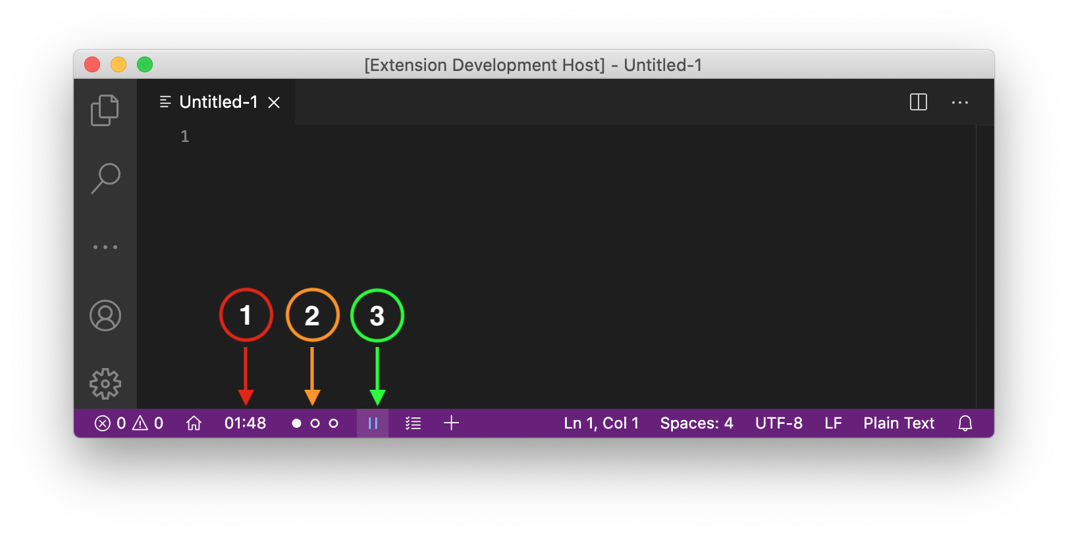
Feature Overview - Timer Interface & Control
① Time remaining
② Cycle progress
③ Pause / Resume

Slide 5
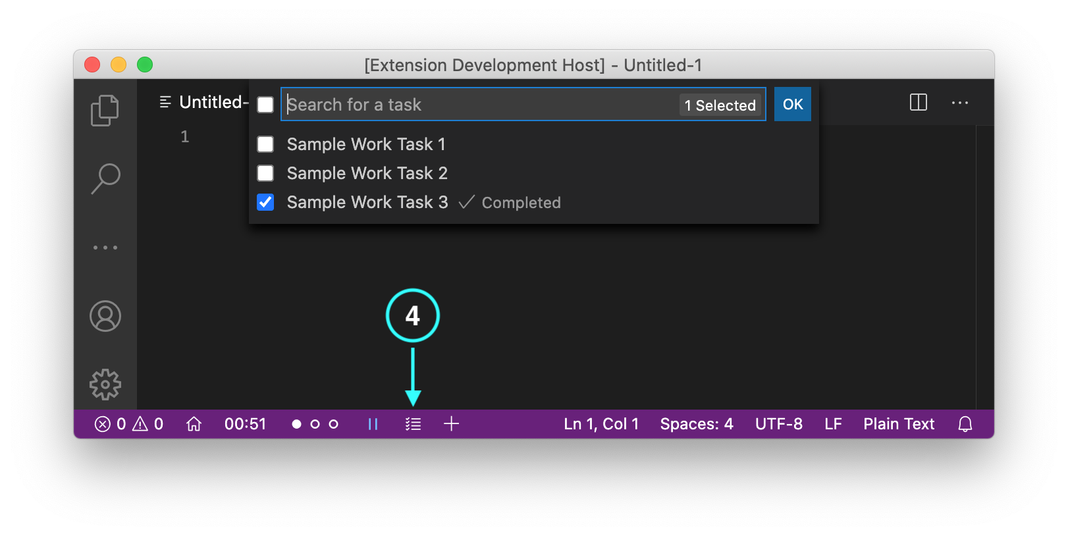
Feature Overview - Task List

Slide 6
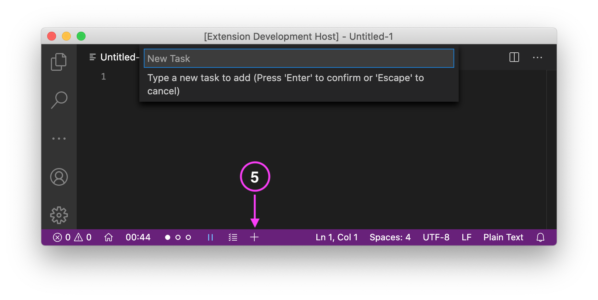
Feature Overview - Adding Tasks

Slide 7
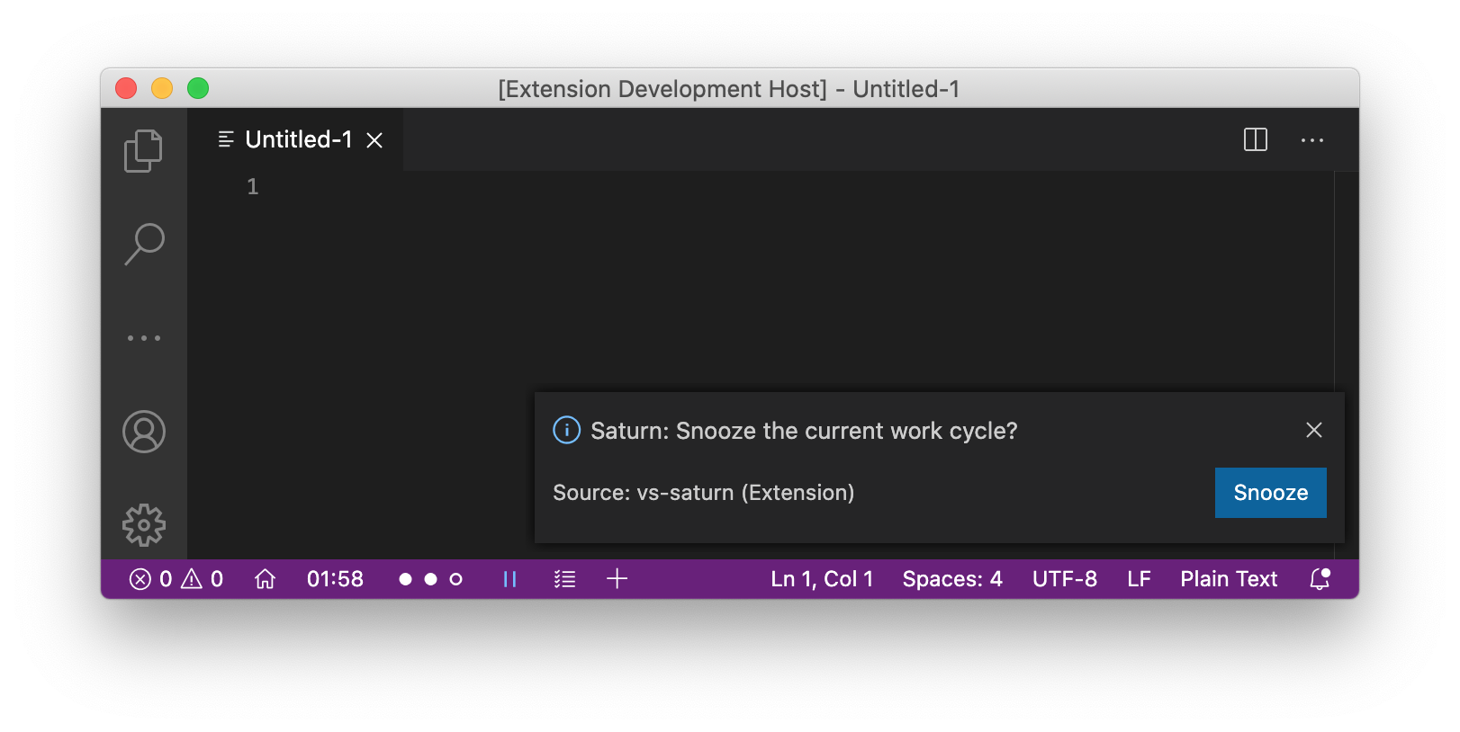
Feature Overview - Timer Notifications & Snooze

Slide 8
Domain Research
VS Code Extension API
TypeScript Language Documentation
Pomodoro Technique
Project Constraints
UI Limitations of VS Code

Slide 9
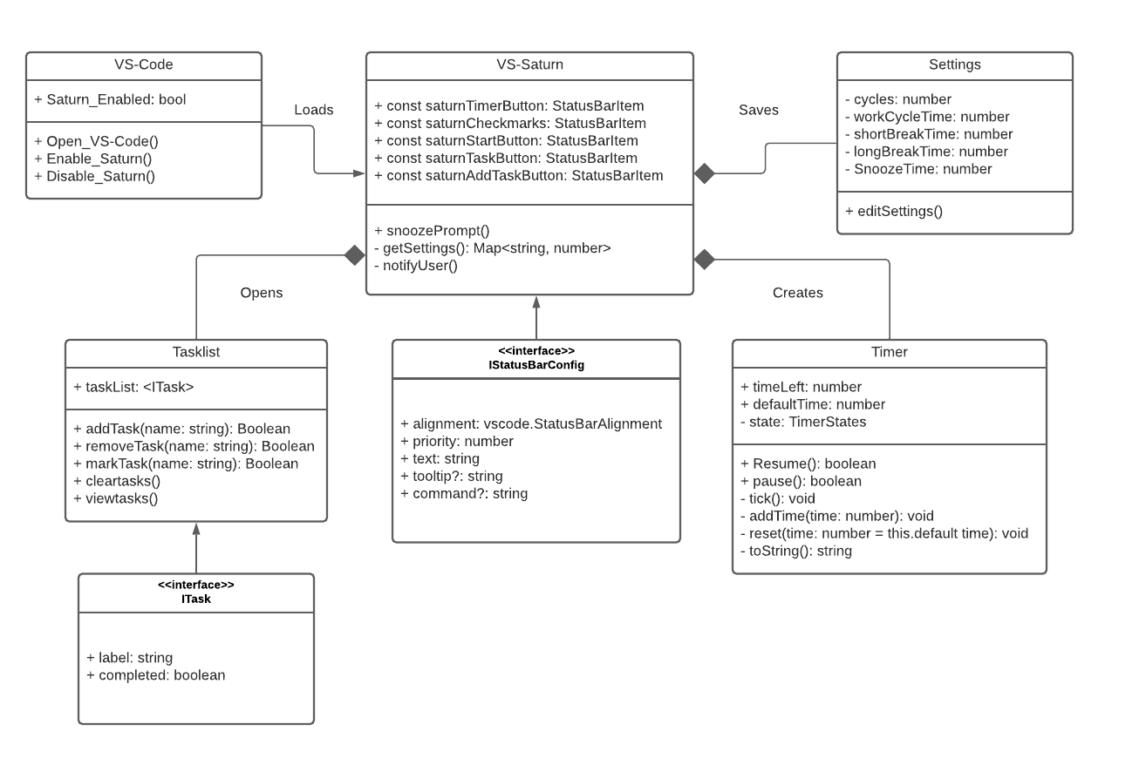
Model-based View of VS-Saturn

Slide 10
Demo: Work Tasklist & Snooze

Slide 11
Demo: Break Tasklist

Slide 12
Demo:
Settings

Slide 13
Acknowledgements
We gratefully acknowledge and appreciate the participation of our customer, Dr. James Daly of UMass Lowell.

